Slide 1
Unit - 3
Letter Types /Format
Types of letters in English
Formal letter. It is a type of letter that follows a certain pattern and formality. ...
Informal Letter. ...
Business letter. ...
Official letter. ...
Social Charter. ...
Circular letter. ...
Employment letters.

Slide 2
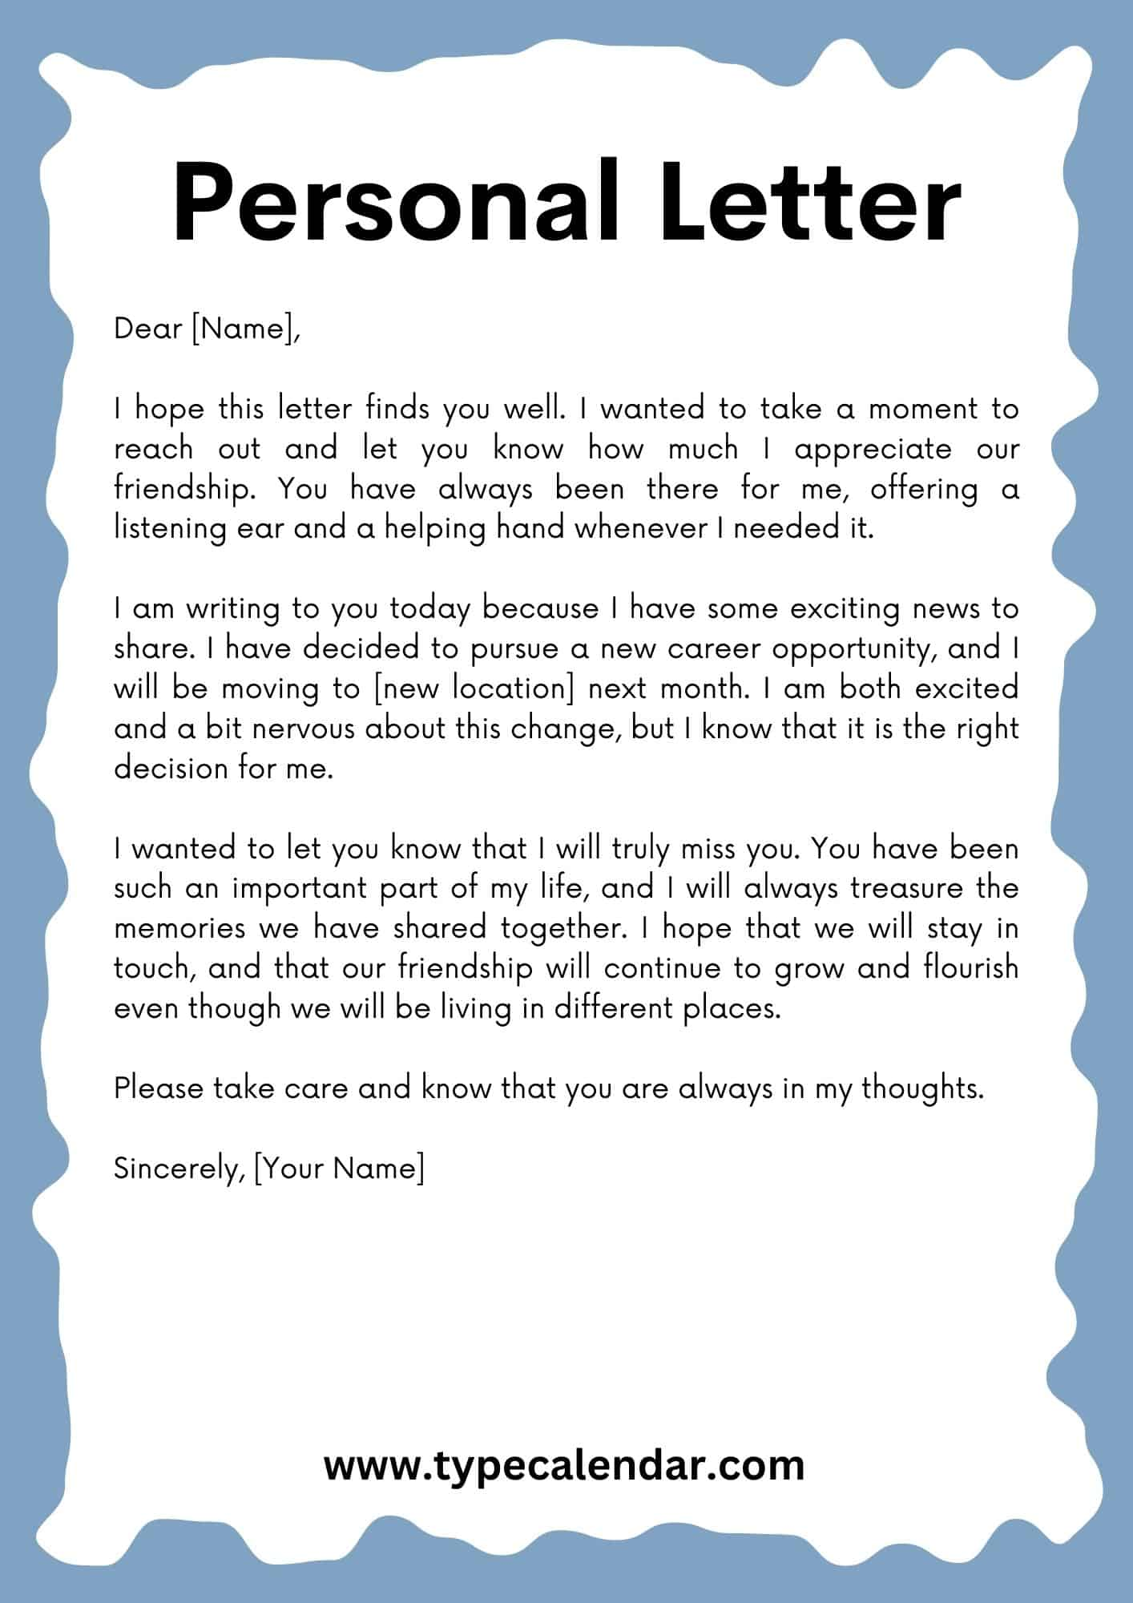
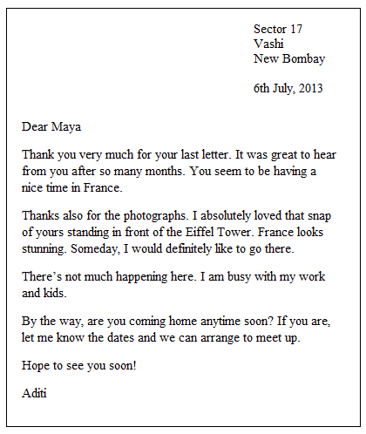

Slide 3
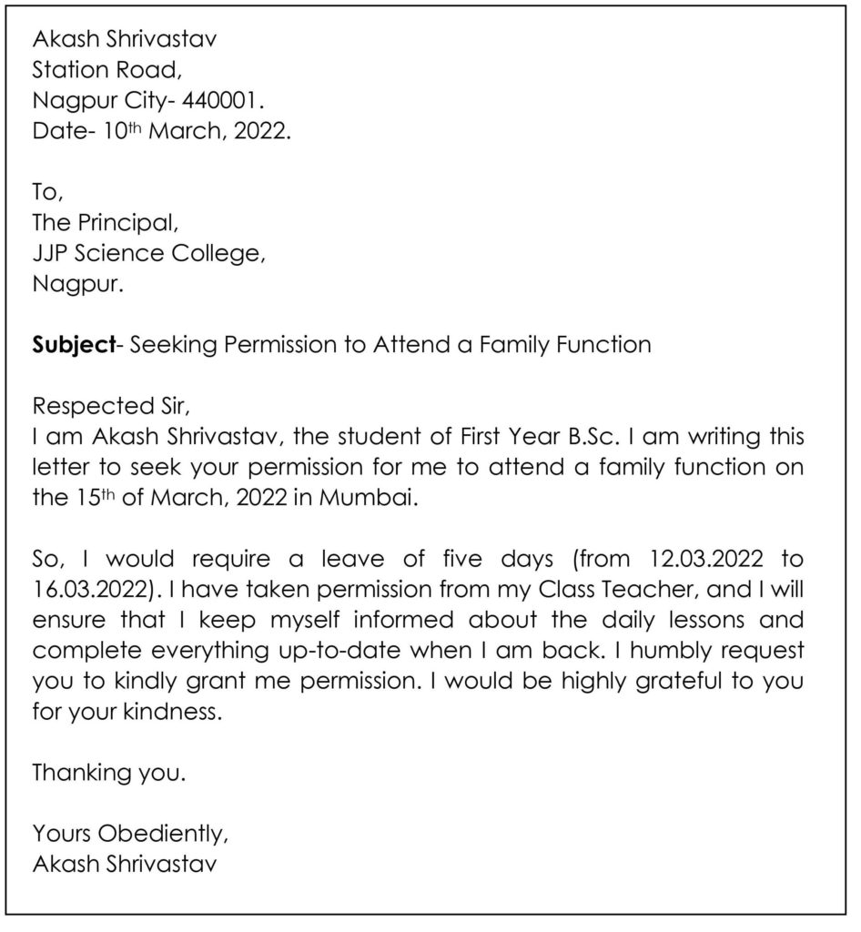

Slide 4
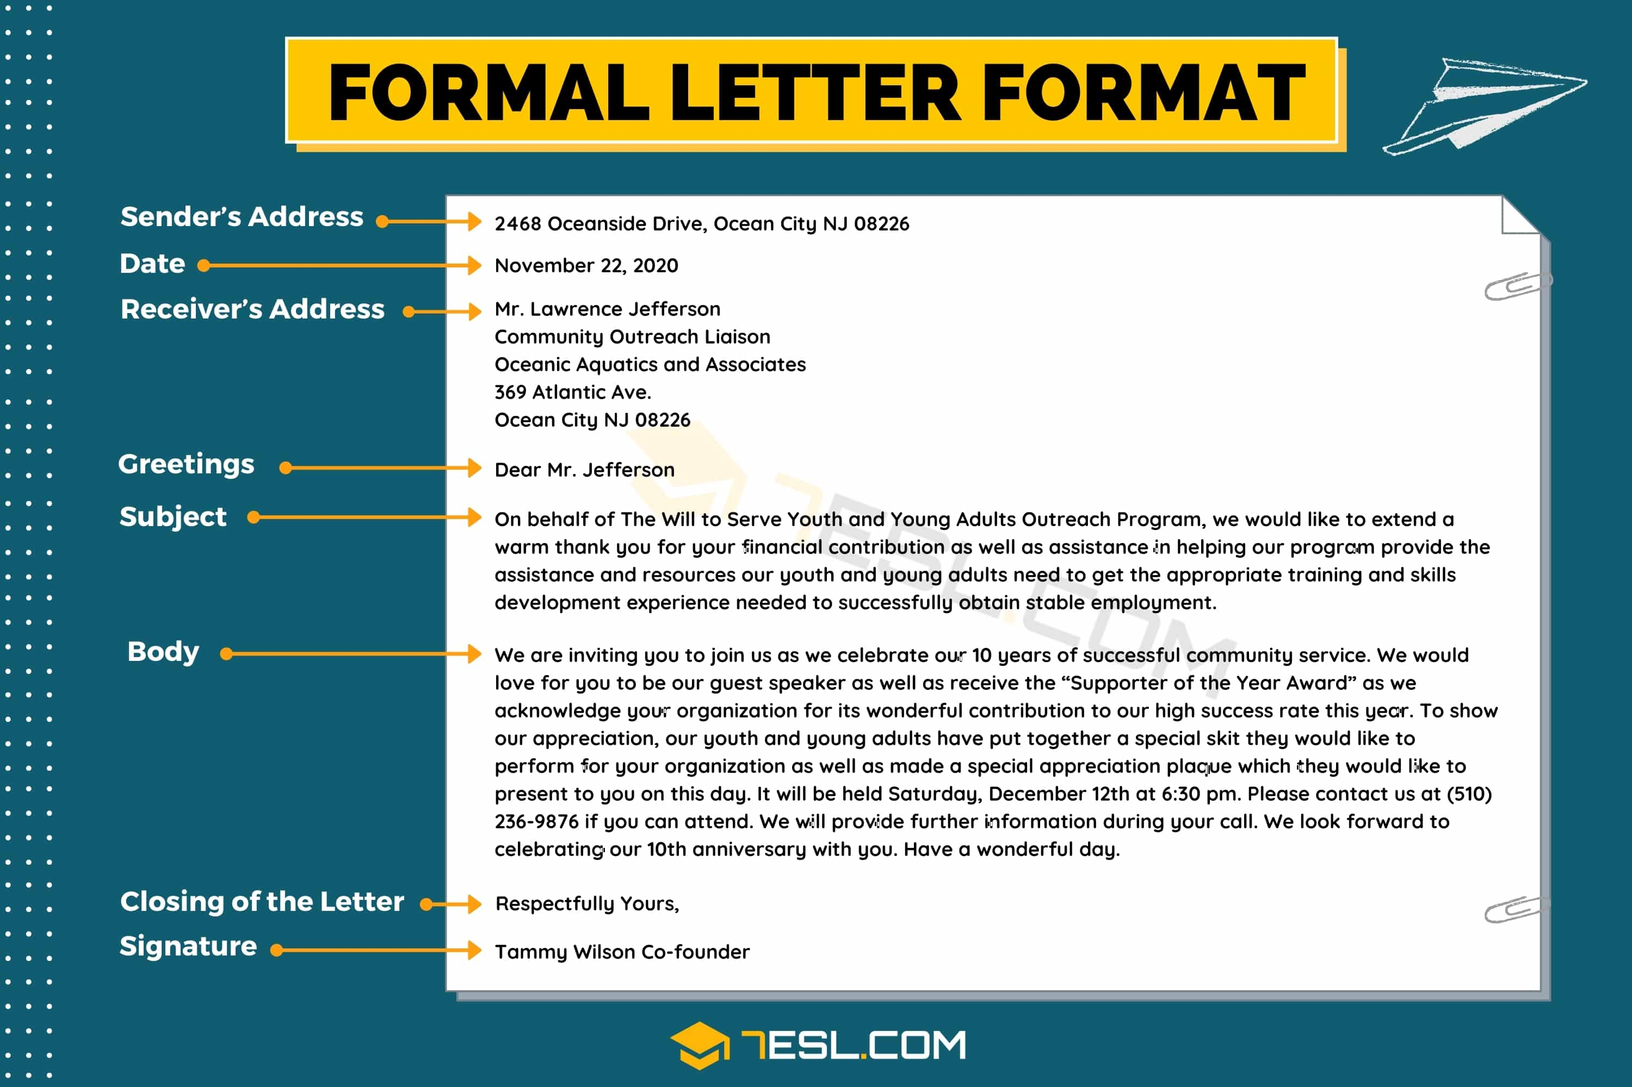

Slide 5
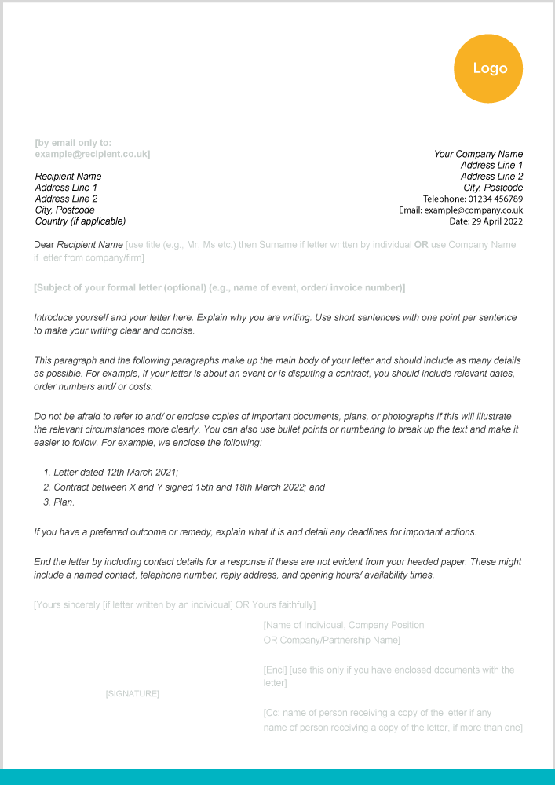
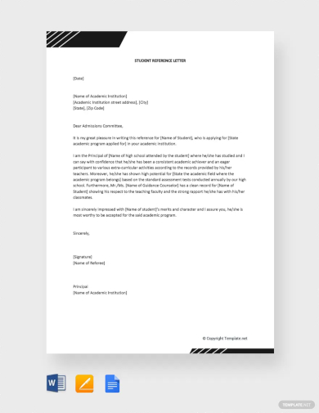

Slide 6
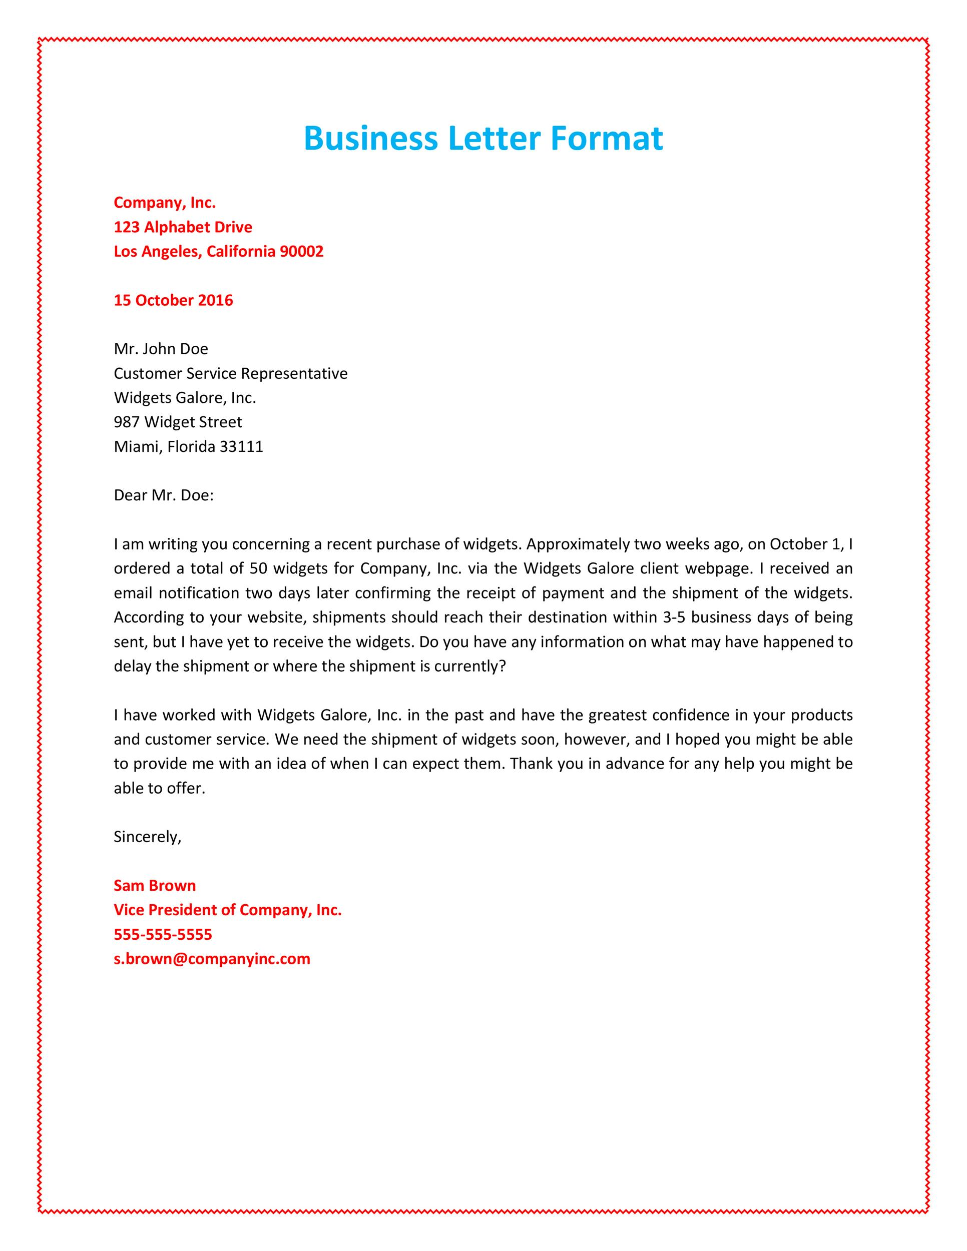
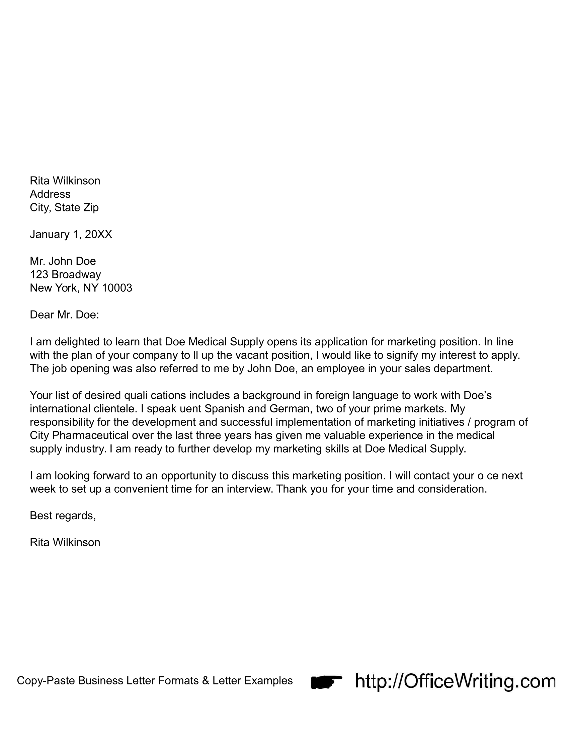

Slide 7
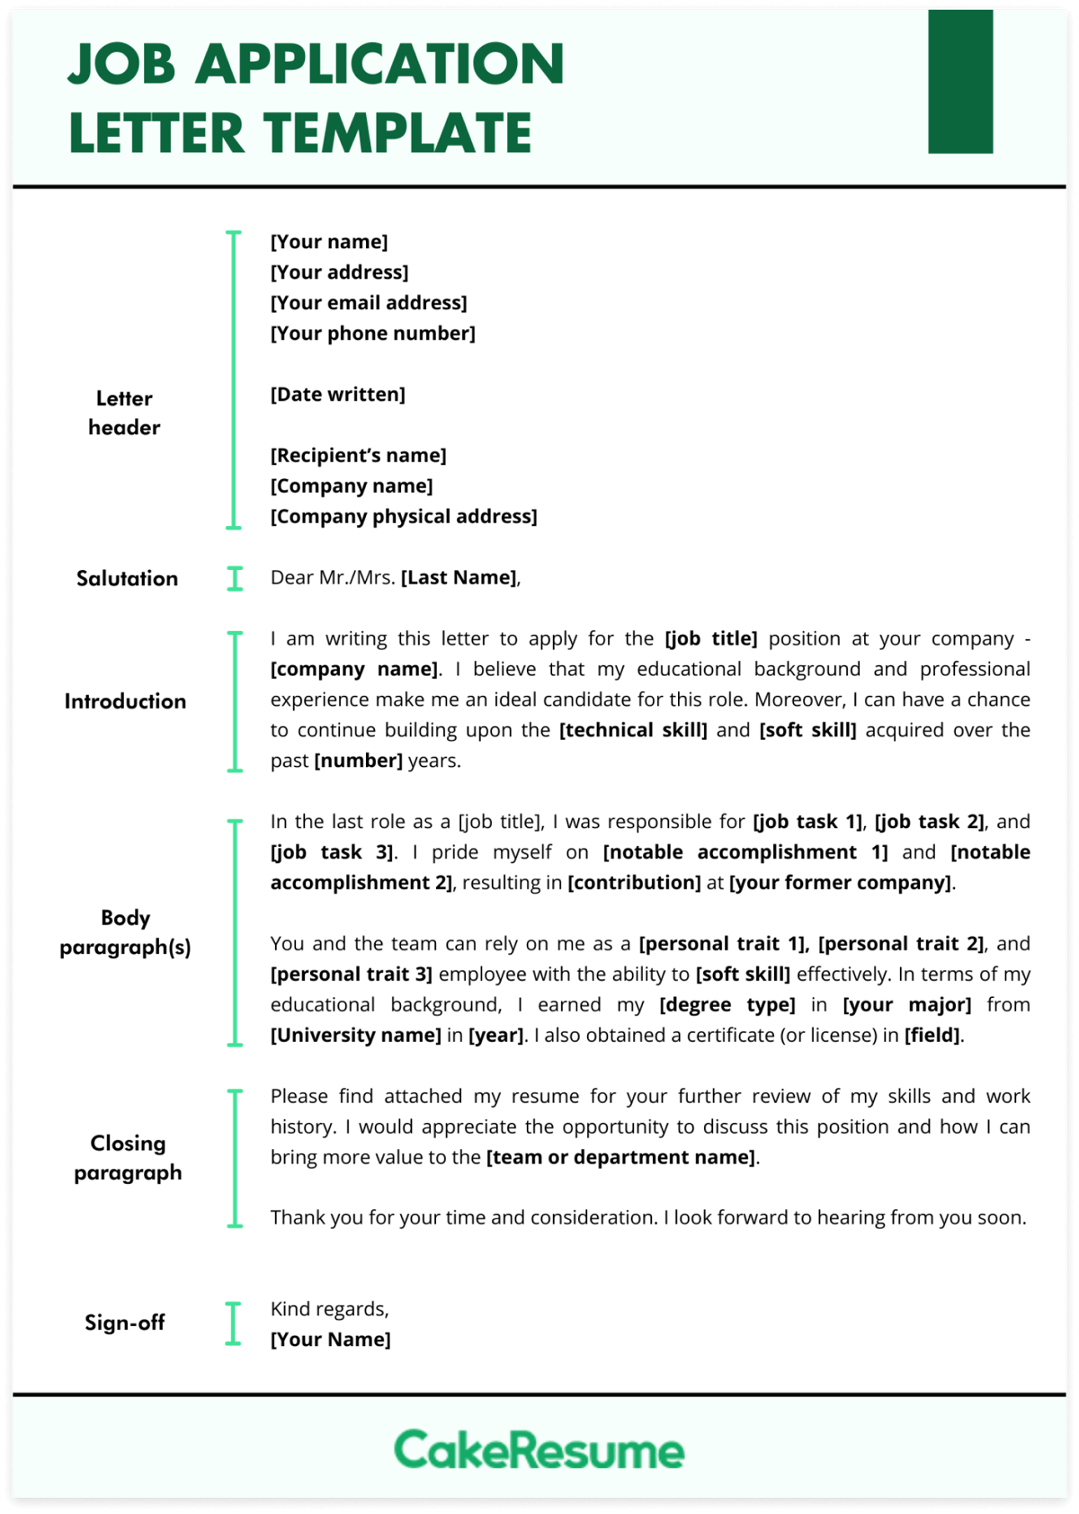

Slide 8
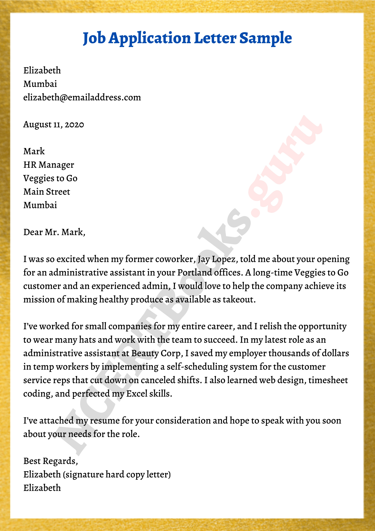

Slide 9
Write a letter to the Mayor of your municipality, asking for some funds to organize an awareness raising program on collecting biodegradable and non-biodegradable. [5]
Write a job application letter to an IT company for the post of IT personnel. [5]
Write a personal letter to your friend asking him/her for economic support for few weeks. [5]

